Slide 1

© 2016 Ciaran Owens, Newcastle University Computing and Technology Society
Free for members’ personal use

Slide 2
How these sessions work
10-15 minute learning session
Step by step hands on project
Your own experiments – can be what you learned today or absolutely anything!
Remember if you see this warning sign, you should pay close attention otherwise you might damage something!
!

Slide 3
Where can I get help?!
Ask one of us around the room
Check the Arduino documentation at https://www.arduino.cc/en/Main/Docs
Google (sometimes searching works better than you think!)
This deck will be available publicly after the presentation

Slide 4
What we’re covering today
Arduino basics (Arduino 101)
Getting the IDE installed
Basic Variables
Digital Input and Output
For and While Loops
Project 1 – Making LEDs Flash
Challenge/Experiment ideas

Slide 5
ARDUINO 101 – the board
2
4
USB Port for Programming [1]
GPIO Pins for cool stuff [2]
DC Power socket [3]
Reset Button [4]
1
3
2

Slide 6
ARDUINO 101 – THE BREADBOARD
Also known as a prototyping board
Used for plugging all your cool stuff into the Arduino GPIO pins
It’s very easy to miss-wire something when you have lots of connections, so always double check before turning on your Arduino!
Note how we have a grid of connections
!

Slide 7
ARDUINO 101 – THE BREADBOARD
Split down the middle
Power rails are separate
Looking at the board this way, all of the connections that aren’t power rails are wired vertically (i.e. Column 1 is all wired together but Row A is not wired together)
On some, the power rail is also split in the middle – you can tell if there’s a gap

Slide 8
InstalLING AND CONFIGURING THE IDE
Plug in your Arduino
Download & install the IDE from https://www.arduino.cc/en/Main/Software
Go to Tools, Board, select “Arduino/Genuino Uno”
Go to Tools, Port, select the COM with the largest number (this is most likely to be your Arduino’s serial port)
…Now we can start playing around with our Arduinos!

Slide 9
Our first sketch
void setup(){} – This is where we normally assign our GPIO pins here (it’s easier than it sounds, promise!)
void loop(){} – This is where we construct the meat and potatoes of our Arduino program
pinMode(pinNumber, OUTPUT/INPUT) is the function used to assign INPUT or OUTPUT responsibilities to a single GPIO pin
Notes:
First demo – show example of integers defined in setup() translating to pinouts with some sort of function in loop()

Slide 10
Basic understanding of variables
Note the capitalisation is very important – otherwise Arduino will think it’s something completely different!
More variables exist than this table, but this is probably what you’re most likely to use while you’re learning the basics of Arduino
Type | Description | Usage
int | Integer – whole numbers | int x=6;
String | String – strings of text | String s=“My name is Ciaran”;
boolean | Boolean – True of false | Boolean b = true;
single | Single – decimal/floating point number | single i=4.6;
double | Double – decimal/floating point number (more accurate) | double n=5.4213;

Slide 11
Some example code
The next examples will show you how to define these variables, and also make practical use of them
Notes:
Integer arithmetic example with LED (if var > 10 then make LED do cool stuff or make a buzzer go crazy)

Slide 12
ARDUINO FUNCTIONS: DIGITALREAD() AND DIGITALWRITE()
These functions allow us to read values as High or Low
Assuming pinNumber is set to OUTPUT, we can do this to turn it on and off: digitalWrite(pinNumber, HIGH); // This turns the pin on digitalWrite(pinNumber, LOW); // This turns the pin off
digitalRead is similar in concept – if the input is high then the value is high, and vice versa

Slide 13
ARDUINO FUNCTIONS: DIGITALREAD() AND DIGITALWRITE()
Assuming pinNumber is set to INPUT, and we have an int val=0; we can do the following: val=digitalRead(pinNumber);
What’s cool is this function is essentially binary; if the above method returns HIGH, it sets the value of val to 1. If it returns LOW, the value of val is then 0. Just like turning a light on or off. Cool, huh?
What this tells us is digitalRead and digitalWrite only ever have two states: HIGH and LOW.

Slide 14
Loops
Loops make the world go round (quite literally)
Used to do lots of things repeatedly (which is great for batch processing)
Can have different conditions to end the loop
Two primary types of loop: for and while

Slide 15
For loop
Typed as for (int i = 0, i < 3, i++) { //code to run here; }
Note how we have 3 parameters for the for loop: first we have an iteration variable, a condition to make the loop run (while i is smaller than 3), and an iterator (increase i by 1 every time the loop completes)
Notes:
Do demo of making LEDs flash with a for loop until a certain variable is hit

Slide 16
While loop
If we declare a while loop in loop(), we can use it for button conditionals and have it do cool stuff
Example: while(digitalRead(button)==HIGH){ //do cool stuff here; }
Notes:
Do demo of while loop – demonstrate that because it is declared in loop() that stuff that’s not supposed to work, works.

Slide 17
project 1 – making leds flash
This is a very quick project that should get you used to wiring up the Arduino and throwing the whole thing together
First we will take a look at how to assemble the project by using the breadboard, some LEDs, some resistors and a bunch of jumper wires
Finally, we’ll write the code that makes it all work!

Slide 18
Project 1 – breadboard setup notes
Always double check the LED polarity – we can figure this out by looking at the legs – the longer leg is the positive (+) side. The flat edge on the LED casing also marks the negative (-) side
We need to make sure we have a 330 ohm resistor in series with the LED to stop it from drawing too much current and blowing
!
!

Slide 19
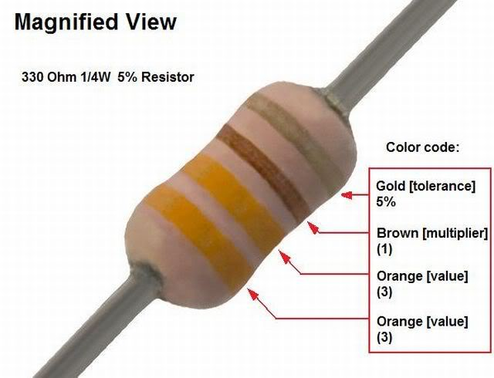
Project 1 – breadboard setup notes
Find a 330 ohm resistor in your kit – you can identify it as the first three colours on it should be orange, orange, brown. The resistor should have four colours on it, but we don’t need to worry about the fourth colour for now.

Slide 20
Project 1 – Building the project
We have to start wiring our board
We will use pin 13 on our Arduino for the LED control
We need to connect 5V to the + rail of our breadboard
We need to connect GND to the – rail of our breadboard
Let’s assemble it!

Slide 21
Project 1 – Writing the Code
First we need to declare our variables, and also setup the pinMode() function to OUTPUT, so our pin can send power to the LED
Next, we need to write some code in the main program loop to turn the LED on and off using digitalWrite() and delay()
Now we need to send the code to the Arduino and watch it do magic stuff!

Slide 22
Project 1 – observations
The main program loop runs continuously until we turn the Arduino off
Delay() is required to make LED flashes actually noticeable
It’s super simple to build stuff using Arduino!

Slide 23
Project 2/extension
Let’s add a couple more LEDs to pin 11 and 12 – and declare them in our code as we did with pin 13. Don’t forget the resistors!
Add a couple of for loops in the code that will loop 3 times before ending
Let’s add some code to make the LEDs turn on sequentially then in the second loop, turn off sequentially
Compile, send to Arduino and watch it become your next Christmas tree decoration

Slide 24
Challenge…
Think about how you could change the loops to while loops and use them to make a button activate the cool Christmas lights (hint – it’s all about the digitalRead() hype)
You can find out a little more information about how the buttons work on this fancy page: https://www.arduino.cc/en/Tutorial/Button

Slide 25
Concluding the evening
Tonight we learned more than you think:
Basic loops including use of them conditionally
How Arduino loves spaghetti code
How to define specific pins to do specific tasks
How not to blow LEDs (happens more commonly than you think…)
How to throw cool stuff on a breadboard and watch it work

Slide 26
Concluding the evening
This deck will be available online – https://github.com/ohms360/CodespaceArduino
Feel free to grab one of us to ask questions
Drop me an email and I will do my best to reply within a few days (I’m terrible at answering emails, c.owens1@ncl.ac.uk)
Try some of this Arduino stuff when you get home and show us what you’ve made next week (if you want)!

